Slide 1
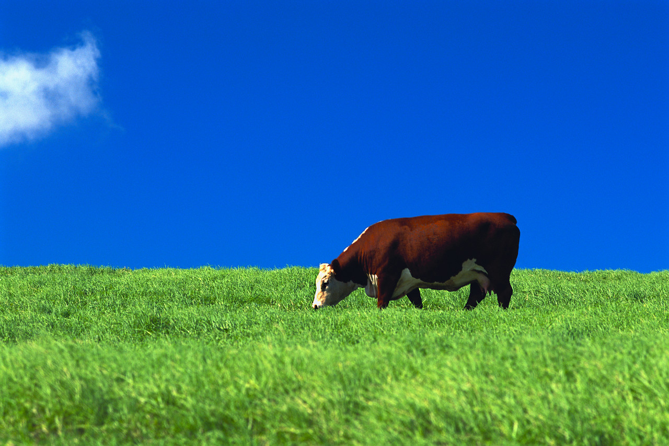

NZ Beef Expo 2017
A seedstock operation focussed on genetic gain
Ian Locke
Wirruna Poll Hereford Stud
“Spring Valley” Holbrook NSW
Notes:
My name is Ian Locke.
Thank you for visiting “Spring Valley”.
My wife Diney & I welcome you....
My topic is.... I will also focus on the importance of genetics and to be sustainable, to drive genetic improvement to become more efficient and better meet market demands.

Slide 2
Outline
The property & enterprises
Why are we different?
Can we change genetics?
Factors that effect genetic improvement
What does genetic gain look like?
Key messages

Slide 3



Wirruna Poll Hereford Stud
Notes:
I am from Australia, located in the far SE corner at a place called Holbrook, located half way between Sydney & Melbourne.
About 25 years ago, I completed a degree in Agricultural Economics at the University of New England in Armidale. After working as an agricultural business consultant for 6 years I returned home in 1994 to manage the family grazing business at “Spring Valley” Holbrook in southern NSW. Called Wirruna Poll Hereford Stud.
Also located at Armidale is the Agricultural Business Research Institute (ABRI) – well known for providing technologies such as Breedplan and HerdMaster software to many parts of the world including South Africa.
I am the current chairman of the International Beef Recording Scheme (IBRS), and sit on the ABRI Board.

Slide 4
The Property
“Spring Valley”
Area: 3,560 Acs.
(1,400 effective Ha)
Rainfall: 708 mm winter dominant
– Reliable Springs 9/10
–Unreliable Autumns 4/10)
Soils/Landscape: Highly variable ranging from
            heavy clay flats to granite based slopes & rocky hills. 80% arable
Fertility: Naturally acidic and inherently infertile ….but very responsive to fertiliser & lime inputs
Pastures: “Pastures are the powerhouse”
Mainly improved perennial pastures –Phalaris and clover
Pasture production curve – work with nature not against it
Notes:
To start with I want to give you a picture of our operation….
The property “Spring Valley” is located 6 km S of Holbrook on the Hume Highway.
The property is largely improved to mostly highly productive phalaris and sub clover pastures and some feed gap pastures such as Lucerne, ryegrass and forage rape.
Pastures that not just survive, but THRIVE
Well fertilised and managed with a grazing system that allows the pastures to be periodically rested.
Grazing crops – Country generally seen as too fragile to sustainable crop. But, offer early feed advantages and is a good tool for weed control on the way to establishing a permanent pasture.
Where grass is our major input, we want to understand natural seasonality of growth and the changes in feed quality throughout the year.
Traditionally, Springs are very reliable (10% may fail) and Autumns not so reliable, (60% of Autumns fail).
We grow 80% of our pasture in Spring and therefore our livestock systems are designed around calving and lambing and growing out animals in Spring to best match the pasture production curve. I will speak more about this later in this presentation.

Slide 5
Pasture Growth Curve - Holbrook
Notes:
The property is largely improved to mostly highly productive phalaris and sub clover pastures and some feed gap pastures such as Lucerne, ryegrass and forage rape.
Well fertilised and managed with a grazing system that allows the pastures to be periodically rested.
Grazing crops – Country generally seen as too fragile to sustainable crop. But, offer early feed advantages and is a good tool for weed control on the way to establishing a permanent pasture.
Where grass is our major input, we want to understand natural seasonality of growth and the changes in feed quality throughout the year.
Traditionally, Springs are very reliable (10% may fail) and Autumns not so reliable, (60% of Autumns fail).
We grow 80% of our pasture in Spring and therefore our livestock systems are designed around calving and lambing and growing out animals in Spring to best match the pasture production curve. I will speak more about this later in this presentation.

Slide 6
Matching animal requirements to feed supply
Calving
Notes:
Condition score roller coaster – Cow must be a low cost calf factory

Slide 7
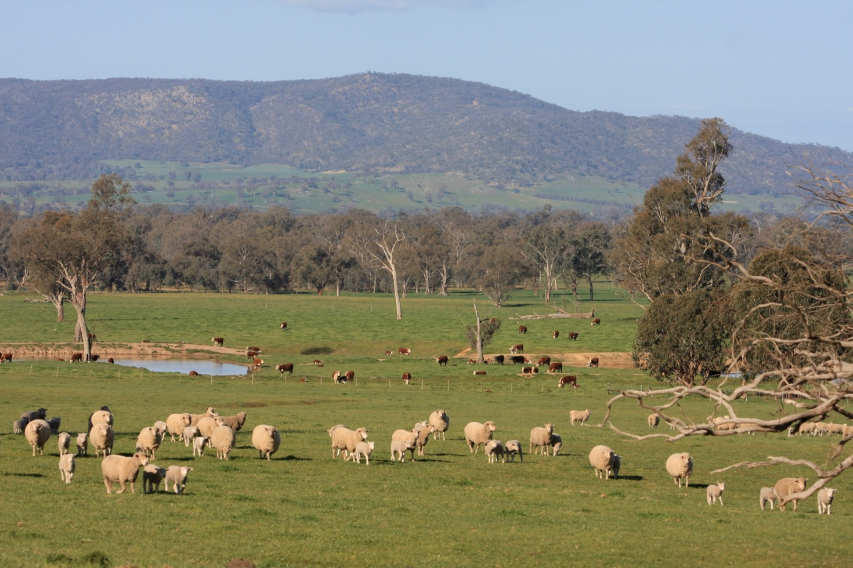
The Enterprises
Enterprise | Current Livestock No.s | Annual Production | Ave DSE %-age
Seedstock Beef Cattle | 1,500 head Join 800 cows/ calve 600 Cows) | Sell 180+ Poll Hereford Bulls/annum 340,000+ kgs beef cattle | 70%
Prime Lamb Flock (LAMBPRO) | 3,000 ewes (4,000 lambs) Primeline self-replacing maternal composites | 3,000 prime lambs (stores) Surplus ewes 10,000kg greasy wool | 30%
Notes:
The enterprises are principally seedstock cattle & prime lambs.
These enterprises are run as hard as we can with a focus on per HA performance rather than production per head!
We aim to run high production and profitable enterprises by driving down costs/kg of production.

Slide 8
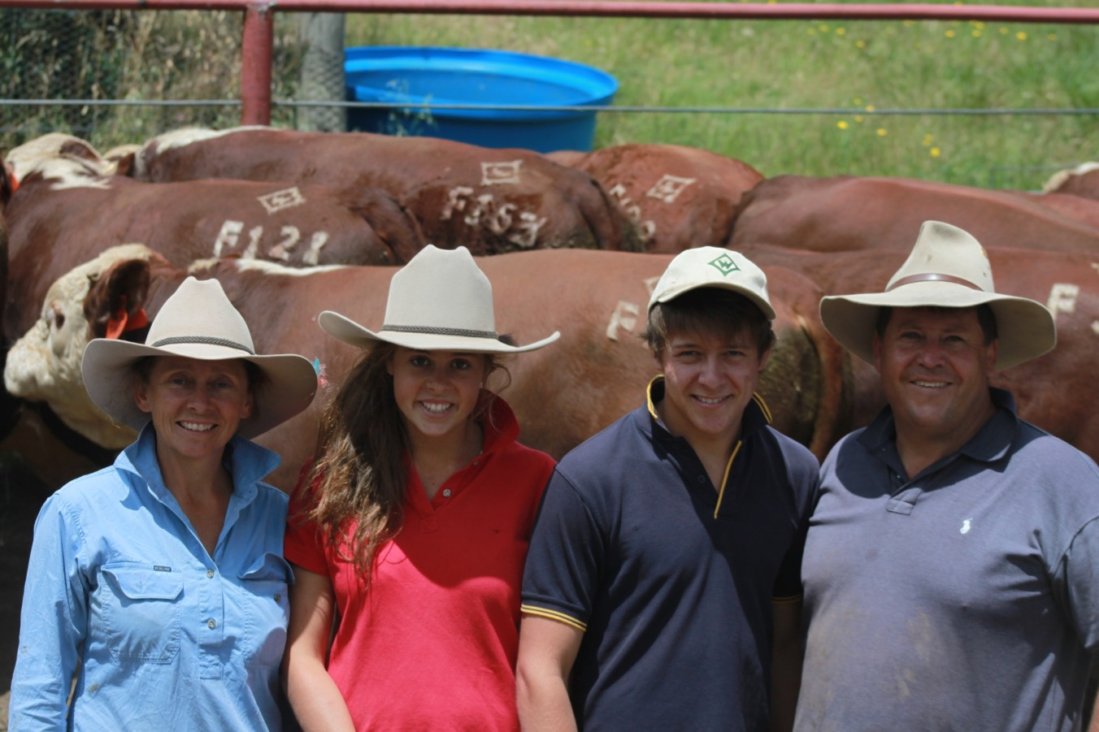
Wirruna Poll Herefords
The Seedstock Business:
  3rd generation - Ian & Diana Locke
  Established 1949 (68 years)
  Ceased showing cattle in 1972
  Performance recorded under grass fed conditions
  Shift from phenotype focus to genetic focus - Challenging
  Seedstock Producer of the Year in 1995
  The Conundrum of the stud industry:
  “The Stud world can afford to change the environment to suit their genetics. The commercial beef producer, on the other hand, can only afford to have the genetics that suit their environment”
  Why are we different?
Notes:
The Seedstock beef enterprise differs from most studs in that we place large emphasis on raising cattle under commercial stress conditions. There is no pampering going on.
I am the 3rd generation of Locke’s to manage the Wirruna herd, which was established by my Grandfather in 1949.

Slide 9
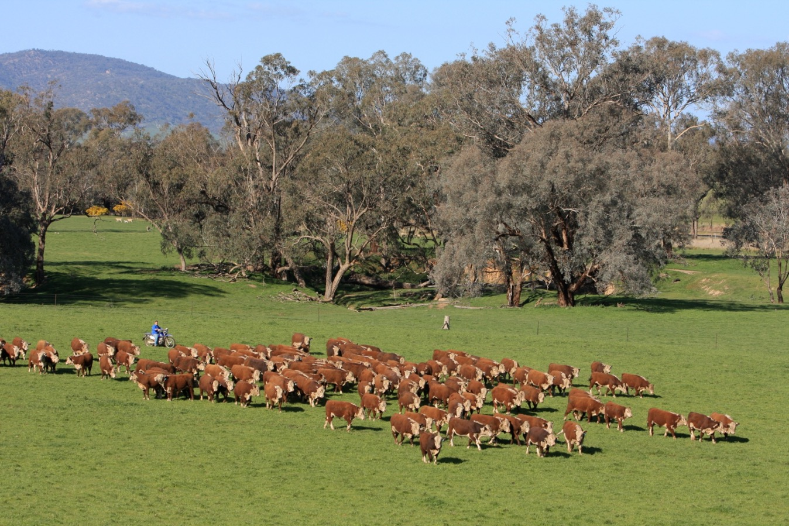
Why are we different?
Alignment to the commercial beef producer
  Modelled on 4-5 top commercial beef producers
  Benchmarked to identify key profit drivers
  Tightly managed – 6 week joining/calve at 2yrs
  Feed for maintenance – not production
  Run under high stocking rate with a Kg Beef produced/Ha focus
  Better genetic outcomes for commercial beef producer
Notes:
The herd benefits from a long history of selection and is among the best performance recorded herds in the country, having been part of the validation of the Breedplan system and now having over 9,000 animals performance recorded, including over 6,000 birthweight records and 4,000 carcase scan records.
Breedplan has been an excellent tool for us to Benchmark individual genetic traits and the genetic progress of the herd.
The other form of Benchmarking that has been the foundation to my thinking is the Farm Benchmarking service offered by Holmes & Sackett. This has given me a better focus on the commercial profit drivers.

Slide 10
Notes:
This graph shows that we drove stocking rates from around 11 dse/Ha to 15 dse/Ha over the mid 90’s to mid 2000’s (around 50% above district average). The prolonged recent drought has seen a decline in stocking rates but we will be returning to >20,000 dse in the near term.
In a breeding operation, this happens slowly –although can be assisted with trade stock.
But the real point is the widening of the gap between annual stocking rate and winter stock rates. Having enterprises that better utilise the Spring flush and grazing management systems that allow the highly improved country to get away after the Autumn break can vastly assist overall farm production.

Slide 11

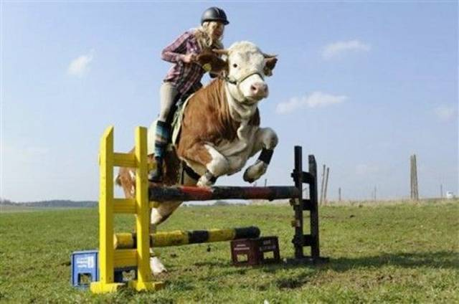
The Hurdle System
The Production System
  A cow herd focus – ‘Litmus Test’ of genetics
  Disciplined system
    All heifers joined at 14-15 months
    PTIC in 2 cycle joining
    Must have a live unassisted calf at 2 years
    All cows must continue to bring a live unassisted calf through to weaning; every year!
  “All cattle that fail these strict fertility hurdles are culled from the breeding herd – there are no favourites”
Notes:
Stocking rate is totally in the control of management.
One of my criticisms of the stud industry is that they change their environment to suit genetics. Commercial beef breeders must have genetics that suit their environment.
Stock rate often limited by attitude of management

Slide 12

Why are we different?
Strive for high quality genetic data
  Invest in Phenotypic data
  Run in large management groups
  Fully recorded on Breedplan
  Invest in genomics & connectedness to reference population
  5 star completeness of performance herd
Completeness of Performance Star Ratings
Notes:
The herd benefits from a long history of selection and is among the best performance recorded herds in the country, having been part of the validation of the Breedplan system and now having over 9,000 animals performance recorded, including over 6,000 birthweight records and 4,000 carcase scan records.
Breedplan has been an excellent tool for us to Benchmark individual genetic traits and the genetic progress of the herd.
The other form of Benchmarking that has been the foundation to my thinking is the Farm Benchmarking service offered by Holmes & Sackett. This has given me a better focus on the commercial profit drivers.

Slide 13
Understanding Genotype from Phenotype
Notes:
There are several key factors influencing the rate of genetic improvement in the seedstock herd:
Selection differential-the greater the genetic superiority of the parents, the greater the genetic gain
Generation Length-the younger the age of the parents, the quicker the generation turnover and the greater the genetic gain
Accuracy-the better the quality and quantity of data recorded, the higher the accuracy of our estimation of an animal’s ‘true breeding value’ becomes. Therefore, the response achieved from a breeding program will be increased.
Given the relationship between genetic superiority of the selected animals and the rate of genetic improvement that is achieved, the important link is that we must also know how to identify these animals that are, in fact, genetically superior. It is often a challenge to “see” many of the traits that influence the profitability of a beef enterprise. For example; it is hard to tell what level of marbling a bull’s progeny may have or how fertile his daughters will be compared to another bull by assessing them visually.
We do have objective measurement such as physical weights and carcase scanning, however, this can be complicated by a raft of non-genetic factors such as nutrition, disease status and age. The implication of this is “What you see is not necessarily what you get”.
Even the most astute cattlemen find it difficult making selection decisions that are not clouded by differences between animals, that are due to non-genetic factors.
To make genetic improvement, it is imperative that selection decisions are based on genetic differences between animals. The BREEDPLAN® system was developed for this purpose.

Slide 14
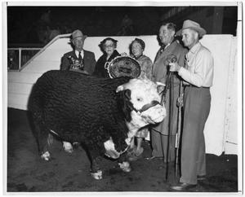
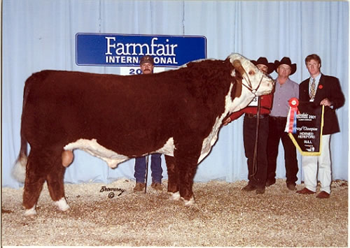
We all know we can make genetic change….
Champion Bull 1960
Champion Bull 2001
The key is to be making genetic improvement.
Notes:
Selection for increased carcase yield and carcase value has become an increasingly important objective for breeders of cattle.
One of the ways of improving carcase traits in your animals is through GENETICS
We know that we can change animals over time with genetic selection. In 40 years, the Champion Hereford Bull of 1960 has been dramatically changed to those of the 2000’s.
The smaller cattle of the 1960's were at that time promoted for their smaller beef cuts suiting the ‘modern’ housewife. By the 1990's the show ring judges were encouraging much bigger framed cattle with claims of maximum feedlot performance and efficiencies on kill floors with greater carcase weight and less fat trim.
For me, in our cattle production environment, the optimum frame (maturity pattern) is somewhere in between these extremes. These extremes in genotype do highlight, however, that we can significantly change animals overtime.
Too often, the efforts of some in the stud industry are to change the genotype of cattle to chase the latest fad or fashion in cattle. This is often achieved through an unhealthy concentration on too few traits. This seems to be encouraged in the show ring where the breeding signals are not necessarily in the best interests of the commercial beef sector.
Good cattle breeders understand there are many trade-offs where breeding for one trait can have adverse consequences on others. Leading seedstock producers will be concentrating on making genetic improvement across a large range of traits simultaneously, with the relative importance given to each trait determined by the influence that the trait has on the profitability of the beef enterprise. When involving many traits, the rate of genetic improvement is often ‘inherently’ slow. But the best thing about genetic gain is that it is both cumulative & permanent. It may take time but the genetic gains are permanent improvements to beef production system and the associated economic consequences. The key is to make gains in the economically relevant traits.

Slide 15
Factors effecting rate of Genetic Improvement
R = i x r x σ_{g}
L
R = Response to Selection
i = Selection intensity
r = accuracy to selection
σ_{g} = Genetic variation
L = Generation Length
What can the seedstock producer do to increase their rate of genetic gain?
Notes:
Nature is too expensive to fight, so must design a system to work with it!
Calving time is an important step in matching animal requirements to you pasture growth curve
One of the key measures of success of any seedstock breeding enterprise is the genetic improvement that is made in their breeding program from one year to another.
In a climate of declining terms of trade genetic improvement is a vital tool to improve phenotype, performance, efficiency and ultimately the profitability in both seedstock and commercial herds.
Genetic
business

Slide 16
What can the seedstock producer do to increase their rate of genetic gain?
R = i x r x σ_{g}
L
i = Selection intensity
The higher the selection intensity simply means the higher degree of superiority of the animals selected for breeding
Use animals with preferred EBVs & higher $Index values
AI and ET programs
Heifers selection vs Bulls selection
Notes:
Nature is too expensive to fight, so must design a system to work with it!
Calving time is an important step in matching animal requirements to you pasture growth curve
One of the key measures of success of any seedstock breeding enterprise is the genetic improvement that is made in their breeding program from one year to another.
In a climate of declining terms of trade genetic improvement is a vital tool to improve phenotype, performance, efficiency and ultimately the profitability in both seedstock and commercial herds.
Genetic
business

Slide 17
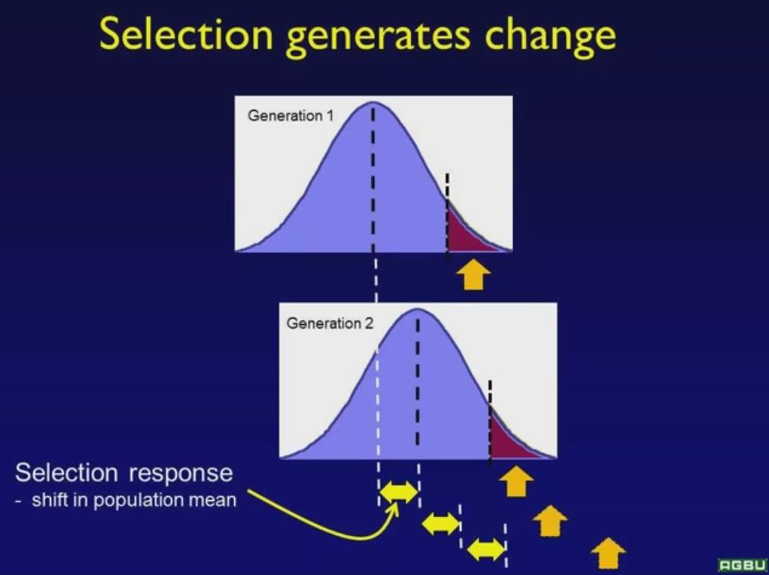
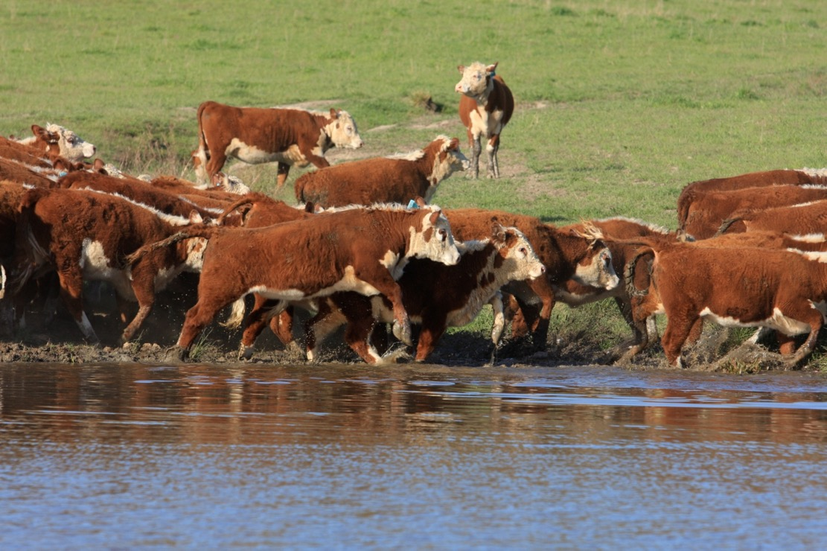
The Production System

Slide 18
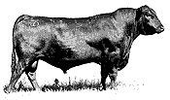
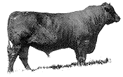
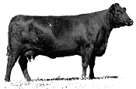
Genetic improvement is largely driven by the sires you buy…
Maternal Great -
Grand Sires (12.5%)
Maternal Grand Sires (25%)
Sires (50%)
87% of genetic composition of calf crop is determined by the sires used over the last 3 generations

Slide 19
What can the seedstock producer do to increase their rate of genetic gain?
R = i x r x σ_{g}
L
r = Accuracy of selection
Accuracy is influenced by factors like heritability and the quality & quantity of information available. Improve accuracy by:
Full and diligent recording within breeding program
Measure more traits within the breeding objective
Proven bulls v younger bulls
DNA can improve accuracy
Notes:
Nature is too expensive to fight, so must design a system to work with it!
Calving time is an important step in matching animal requirements to you pasture growth curve
One of the key measures of success of any seedstock breeding enterprise is the genetic improvement that is made in their breeding program from one year to another.
In a climate of declining terms of trade genetic improvement is a vital tool to improve phenotype, performance, efficiency and ultimately the profitability in both seedstock and commercial herds.
Genetic
business

Slide 20
What can the seedstock producer do to increase their rate of genetic gain?
R = i x r x σ_{g}
L
σ_{g} = Genetic variation
The greater the Genetic variation provides a greater potential to make genetic improvement: Although generally less scope to influence, genetic improvement can be made by:
Expanding the gene pool – OS sires
Crossbreeding
Notes:
Nature is too expensive to fight, so must design a system to work with it!
Calving time is an important step in matching animal requirements to you pasture growth curve
One of the key measures of success of any seedstock breeding enterprise is the genetic improvement that is made in their breeding program from one year to another.
In a climate of declining terms of trade genetic improvement is a vital tool to improve phenotype, performance, efficiency and ultimately the profitability in both seedstock and commercial herds.
Genetic
business

Slide 21
What can the seedstock producer do to increase their rate of genetic gain?
R = i x r x σ_{g}
L
L = Generation Length
Average age of the herd. The shorter the generation length, the greater genetic improvement can be achieved.
Use higher proportion of heifer drop
Calve at 2 years
Use yearling bulls
Notes:
Nature is too expensive to fight, so must design a system to work with it!
Calving time is an important step in matching animal requirements to you pasture growth curve
One of the key measures of success of any seedstock breeding enterprise is the genetic improvement that is made in their breeding program from one year to another.
In a climate of declining terms of trade genetic improvement is a vital tool to improve phenotype, performance, efficiency and ultimately the profitability in both seedstock and commercial herds.
Genetic
business

Slide 22
2016 Joining Summary
 | 2015 L’s | 2014 K’s | 2013 J’s | 2012 H’s | 2011 G’s | 2010 F’s | 2009 E’s | 2008 D’s | 2007 C’s | Total
Donors | 0 | 0 | 5 | 3 | 0 | 0 | 1 | 0 | 0 | 9 | 1%
AI1 | 87 | 65 | 35 | 13 | 8 | 4 | 1 | 0 | 0 | 213 | 50%
AI2 | 85 | 62 | 26 | 13 | 16 | 7 | 2 | 0 | 0 | 211
Natural | 128 | 55 | 52 | 21 | 6 | 5 | 6 | 12 | 1 | 286
Rec 1 | 0 | 0 | 24 | 9 | 13 | 10 | 6 | 0 | 0 | 62 | 14%
Rec 2 | 0 | 0 | 22 | 12 | 16 | 4 | 4 | 0 | 0 | 58
Cul | 6 | 10 | 3 | 5 | 6 | 2 | 1 | 3 | 0 | 36
 | 306 | 192 | 167 | 76 | 65 | 32 | 21 | 15 | 1 | 875
80% of herd are under 4 years old at calving
Notes:
The other form of Benchmarking that has been the foundation to my thinking is the Farm Benchmarking service offered by Holmes & Sackett. This has given me a better focus on the commercial profit drivers.

Slide 23
More on Genetics
Importance of a Breeding Objective
Must suit your environment & production system
  Litmus test genetics via the cow herd
  Power of selection comes via the sires
EBV’s work
Genetic improvement is cumulative and permanent
  Key to sustainable beef production
It’s a balancing act
  Single trait & multi trait
  Know the trade-offs – Between traits/Acc v GL
  Traits with no EBVs
Selection Index

Slide 24
Notes:
The herd benefits from a long history of selection and is among the best performance recorded herds in the country, having been part of the validation of the Breedplan system and now having over 9,000 animals performance recorded, including over 6,000 birthweight records and 4,000 carcase scan records.
Breedplan has been an excellent tool for us to Benchmark individual genetic traits and the genetic progress of the herd.
The other form of Benchmarking that has been the foundation to my thinking is the Farm Benchmarking service offered by Holmes & Sackett. This has given me a better focus on the commercial profit drivers.

Slide 26


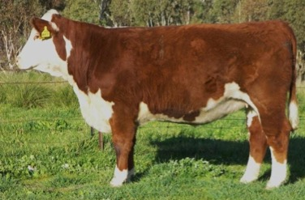
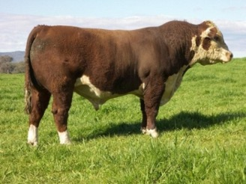

Sourcing genetics from the right breeder will pull you up faster

Slide 27
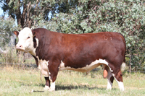
Key Messages
We see our selves as a very different seedstock operation compared to most studs
Disciplined Approach to Breeding
  Raised under commercial stress conditions
  The Hurdle approach
High Level Performance Program
  Renown as one of the most well recorded Hereford herds using Breedplan (over 14,000 recorded cows and some 9,000 birth weight records.)
  Cattle run and recorded in large management groups
A genetic focus
  Genetic improvement is the key measurement of my success as a seedstock producer

Slide 28

Thanks
Website: www.wirruna.com

